Slide 1
Variables, Objects, etc

Slide 2
Dynamically Typed
Python is dynamically typed, meaning that we do not need to explicitly declare the data type of a variable
The interpreter determines the data type based on the value assigned to the variable
Memory allocation to variables has the following aspects (although they are hidden from the programmer):
Object creation
Reference counting
Garbage collection
Memory pools

Slide 3
Object Creation
When we create a new object (e.g., by assigning a value to a variable), Python dynamically allocates memory to store that object's data
The size of the allocated memory depends on the type and structure of the object (e.g., an integer, a string, a list)

Slide 4
Reference Counting
Python uses reference counting to keep track of how many references (variables or data structures) point to a particular object
Every object has an associated reference count that is incremented when a reference to the object is created and decremented when a reference is deleted

Slide 5
Garbage Collection
Python's garbage collector periodically identifies and reclaims memory occupied by objects that are no longer reachable (i.e., their reference count drops to zero)
Circular references (objects referencing each other in a loop) are also managed by the garbage collector, as reference counting alone cannot handle these cases

Slide 6
Memory pools
Python uses memory pools to efficiently manage memory allocation for small objects
Memory pools help reduce the overhead of frequently allocating and deallocating small chunks of memory
Objects of similar sizes are grouped into memory blocks within these pools

Slide 7
Variables
No need to declare data type
The interpreter determines the data type based on the value assigned to the variable
Variable naming: Must start with A-Z or a-z or underscore, then we can have alphanumeric characters or underscores
Variables are case-sensitive and should not be the same as Python keywords
Because of dynamic typing, this is allowed:
x = 10
x = “Hello”

Slide 8
Naming Conventions
Snake Case should be used for functions and variable names
Words are separated by underscores.
Example: number_of_college_graduates
Pascal Case should be used for class names
Identical to Camel Case, except the first word is also capitalized.
Example: GraduateStudent

Slide 9
Variable References
Variables hold references to objects in memory rather than the actual data itself
Multiple variables can refer to the same object
Changes to an object through one variable may affect other variables that reference the same object
Consider a simple statement print (300) … The Python interpreter
Creates an integer object
Gives it the value 300
Displays it to the console
Summary: A Python variable is a symbolic name that is a reference or pointer to an object. Once an object is assigned to a variable, you can refer to the object by that name. But the data itself is still contained within the object.

Slide 10
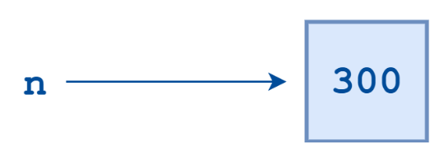
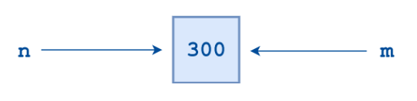
Variable References
Now consider n = 300
This assignment creates an integer object with the value 300 and assigns the variable n to point to that object
Let us now write m = n
Python does not create another object. It simply creates a new symbolic name or reference, m, which points to the same object that n points to.

Slide 11
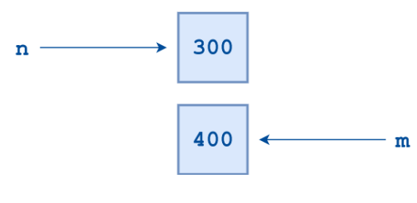
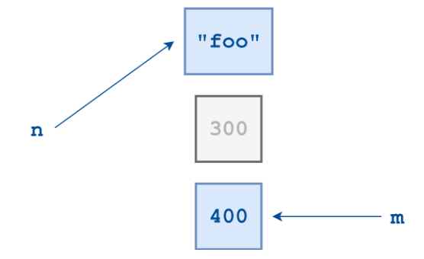
Variable References
What will happen if we now do m = 400?
Now Python creates a new integer object with the value 400, and m becomes a reference to it
Next, we now say n = “test”
We cannot access an
orphaned object
“test”
Orphaned object

Slide 12
Garbage Collection
When the number of references to an object drops to zero, it is no longer accessible
At that point, its lifetime is over – it becomes orphan
Python will eventually notice that it is inaccessible and reclaim the allocated memory so it can be used for something else
This process is referred to as garbage collection

Slide 13
Object Identity
In Python, every object that is created is given a number that uniquely identifies it. It is guaranteed that no two objects will have the same identifier during any period in which their lifetimes overlap. Once an object’s reference count drops to zero and it is garbage collected, as happened to the 300 object above, then its identifying number becomes available and may be used again.
The built-in Python function id() returns an object’s integer identifier. Using the id() function, you can verify that two variables indeed point to the same object:
n = 300
m = n
print (id(n))
print (id(m))
We will see the same id for both
m = 400
print (id(m)
Now it should be different

Slide 14
Literals
A literal is a notation for representing a fixed value in code
Does not require any computation or evaluation
Examples:
Numeric literals: integers, floating-point numbers, and complex numbers, such as 123, 3.14
String literals: sequences of characters enclosed in quotes, such as "Hello, World!" or 'Python'
Boolean literals: the values True and False
None: a special value that represents the absence of a value.
List literals: a sequence of comma-separated values enclosed in square brackets, such as [1, 2, 3].
Dictionary literals: a sequence of key-value pairs enclosed in curly braces, such as {'a': 1, 'b': 2, 'c': 3}

Slide 15
Quoting Rules
Single quote
my_string = 'Hello World’
Double quotes
my_string = "Hello World"
Triple quotes – for multiline strings or to include both ‘ and “ in a string
my_string = """This is a multi-line
string.""“
My_string = ‘’’This string has both ‘ and “ inside.’’’
Escape charater – for escaping special characters
my_string = "Hello \"World\""

Slide 16
Operators
Arithmetic
Assignment
Comparison
Logical
Membership
Bitwise

Slide 17
Arithmetic Operators
+
-
*
/
// (Integer division, returns quotient, e.g. 5 // 3 = 1)
% (Modulus, returns remainder, e.g. 5 % 3 = 2)
** (Exponentiation, e.g. 5 ** 3 = 125)

Slide 18
Arithmetic Operators – Examples
Addition
a = 5
b = 3
c = a + b
print(c) # Output: 8
Subtraction
a = 10
b = 3
c = a - b
print(c) # Output: 7
Multiplication
a = 4
b = 2
c = a * b
print(c) # Output: 8
Division
a = 10
b = 2
c = a / b
print(c) # Output: 5.0

Slide 19
Arithmetic Operators – Examples
Floor division
a = 11
b = 2
c = a // b
print(c) # Output: 5
Modulus
a = 11
b = 2
c = a % b
print(c) # Output: 1
Exponentiation
a = 2
b = 3
c = a ** b
print(c) # Output: 8

Slide 20
Assignment Operators
=
+=
-=
*=
/=
%=
//=
**=

Slide 21
Assignment Operators - Examples
Addition
x += 5 # addition assignment
print(x) # output: 15
Subtraction
x -= 3 # subtraction assignment
print(x) # output: 12
Multiplication
x *= 2 # multiplication assignment
print(x) # output: 24
Division
x /= 3 # division assignment
print(x) # output: 8.0
Modulus assignment
x %= 5 # modulus assignment
print(x) # output: 3.0
Floor division assignment
x //= 2 # floor division assignment
print(x) # output: 1.0
Exponentiation assignment
x **= 2 # exponentiation assignment
print(x) # output: 1.0

Slide 22
Comparison Operators
a = 5
b = 10
print(a == b) # Returns False
print(a != b) # Returns True
print(a < b) # Returns True
print(a > b) # Returns False
print(a <= b) # Returns True
print(a >= b) # Returns False

Slide 23
Identity in Python
Identity is a comparison between two objects to see if they refer to the same memory location
Determined using the is operator
Example: If we have two variables a and b, we can check if they refer to the same object using the is operator:
a = [1, 2, 3]
b = a
print(a is b) # True, since both variables refer to the same memory location

Slide 24
Identity in Python
If we create a new object that has the same value as a, but is a different object in memory, the is operator will return False:
c = [1, 2, 3]
print(a is c) # False, since a and c are two different objects in memory
In Python, lists, dictionaries etc are created differently
Full code
a = [1, 2, 3]
b = a
c = [1, 2, 3]
print (a is b)
print (a is c)
print (id(a))
print (id(b))
print (id(c))

Slide 25
Identity in Python
If we want to compare the values in the two lists, we should use the == operator
a = [1, 2, 3]
b = a
c = [1, 2, 3]
print (a is b) # True
print (a is c) # False
print (id(a))
print (id(b))
print (id(c))
print (a == b) # True
print (a == c) # True

Slide 26
Membership Operators: is (Already discussed) and in
Membership operators are operators used to validate the membership of a value
# Python program to illustrate
# Finding common member in list
# using 'in' operator
list_1=[1,2,3,4,5]
list2=[6,7,8,9]
for item in list_1:
if item in list2:
print("overlapping")
else:
print("not overlapping")
Output:
not overlapping

Slide 27
Bitwise Operators
Bitwise AND (&)
a = 10 # 1010 in binary
b = 6 # 0110 in binary
c = a & b # 0010 in binary
print(c) # Output: 2
Bitwise OR (|)
a = 10 # 1010 in binary
b = 6 # 0110 in binary
c = a | b # 1110 in binary
print(c) # Output: 14
Bitwise XOR (^)
a = 10 # 1010 in binary
b = 6 # 0110 in binary
c = a ^ b # 1100 in binary
print(c) # Output: 12
Bitwise NOT (~)
a = 10 # 1010 in binary
b = ~a # -11 in decimal (11110101 in binary)
print(b) # Output: -11

Slide 28
Bitwise Operators
Left shift (<<)
a = 10 # 1010 in binary
b = a << 1 # 10100 in binary, which is 20 in decimal
print(b) # Output: 20
Right shift (>>)
a = 10 # 1010 in binary
b = a >> 1 # 101 in binary, which is 5 in decimal
print(b) # Output: 5

Slide 29
Logical Operators
and
or
not
x = 5
y = 10
if x > 3 and y < 15:
print("Both conditions are True")
if x > 3 or y > 15:
print("At least one condition is True")
if not(x > 3):
print("The condition is False")

Slide 30
String Handling

Slide 31
String Operators
The + operator concatenates strings
It returns a string consisting of the operands joined together
a = "cdac"
b = " acts"
c = " diot"
print (a + b + c)
C:\delthis>python Hello.py
cdac acts diot

Slide 32
String Functions
Function | Description | Example
chr() | Convert an integer to a character | print(chr(97)) will give ‘a’
ord() | Convert a character to an integer | print(ord(‘a’)) will give 97
len() | Return the length of a string | print(len(‘Hello’)) will give 5
str() | Return the string representation of an object | a = str(49.2) will give ‘49.2’

Slide 33
String Indexing
In Python, strings are ordered sequences of character data, and thus can be indexed
Individual characters in a string can be accessed by specifying the string name followed by a number in square brackets ([])
String indexing in Python is zero-based: the first character in the string has index 0, the next has index 1, and so on
The index of the last character will be the length of the string minus one
h | e | l | l | o
Index = 0 | 1 | 2 | 3 | 4

Slide 34
String Indexing
Example
s = "Hello"
print(s[0])
print(s[3])

Slide 35
Negative String Indexing
String indices can also be specified with negative numbers, in which case indexing occurs from the end of the string backward: -1 refers to the last character, -2 the second-to-last character, and so on
h | e | l | l | o
Positive Index = 0 | 1 | 2 | 3 | 4
Negative Index = -5 | -4 | -3 | -2 | -1

Slide 36
String Slicing
Python also allows a form of indexing syntax that extracts substrings from a string, known as string slicing
If s is a string, an expression of the form s[m:n] returns the portion of s starting with position m, and up to but not including position n:
s = "Hello"
print(s[2:5]) # Start from the first l and go till the end
print(s[2:4]) # Start from the first l and stop at the second l
print(s[2:3]) # Start from the first l and stop there itself
Output: llo ll l

Slide 37
String Slicing
Omitting the first index causes the slicing to start at the beginning of the string
s = "Hello"
print(s[:1])
print(s[:2])
print(s[:3])
print(s[0:3])
Output: H He Hel Hel

Slide 38
String Slicing
Omitting the second index causes the slicing to terminate at the ending of the string
s = "Hello"
print(s[1:])
print(s[2:])
print(s[3:])
print(s[3:5])Output: ello llo lo lo

Slide 39
String Slicing
We can add a stride or step to string slicing
s = "Hello"
print(s[0:5:2])
print(s[1:4:2])
Output: Hlo el

Slide 40
Earlier and New (Formatted) Strings
n = 20
m = 25
prod = n * m
print('The product of', n, 'and', m, 'is', prod)
The product of 20 and 25 is 500
n = 20
m = 25
prod = n * m
print(f'The product of {n} and {m} is {prod}')
The product of 20 and 25 is 500

Slide 41
Modifying Strings
Python Strings are immutable, which means we cannot modify them
s = "Hello"
s[1] = “T” # Error!
We can use one of the following techniques for this:
s = s[0] + “T” + s[2:]
print(s)
OR:
s = "Hello"
s = s.replace("e","T")
print(s)

Slide 42
More String Methods
Many other string functions exist, such as:
Case conversion: capitalize(), lower(), upper(), title()
Find and replace: count(), endswith(), startswith(), find(), replace()
Character classification: isalnum(), isalpha(), isdigit(), islower(), isupper()

Slide 43
Set
A set is an unordered collection of unique elements
Sets are defined using curly braces {} or the set() function
my_prn_set = {1, 2, 3, 4, 5}

Slide 44
Set Example
# Creating a set
fruits = {"apple", "banana", "cherry"}
# Adding an element to the set
fruits.add("orange")
# Removing an element from the set
fruits.remove("banana")
# Checking if an element is in the set
is_mango_present = "mango" in fruits
# Iterating through the set
for fruit in fruits:
print(fruit)
# Finding the length of the set
num_fruits = len(fruits)
# Creating a new set with some common elements
vegetables = {"carrot", "potato", "apple"}
# Finding the intersection of two sets
common_items = fruits.intersection(vegetables)
# Combining two sets (union)
all_items = fruits.union(vegetables)
# Creating an empty set
empty_set = set()
# Printing the results
print("Fruits:", fruits)
print("Is mango present?", is_mango_present)
print("Number of fruits:", num_fruits)
print("Common items:", common_items)
print("All items:", all_items)

Slide 45
Set – Bank Account Types
account_types = {"checking", "savings", "credit", "investment"}
# Print out the account types
print("Account types:")
for account in account_types:
print(account)
# Add a new account type
account_types.add("money market")
# Print out the updated account types
print("Updated account types:")
for account in account_types:
print(account)

Slide 46
Lambda Functions
A lambda function in Python is a small, anonymous function that can have any number of arguments, but can only have one expression
It is often used for short, simple operations
Lambda functions are defined using the lambda keyword, followed by the arguments and the expression
General syntax: lambda arguments: expression

Slide 47
Lambda Function: Example
def add(a, b):
return a + b
result = add(5, 3)
print(result)
add = lambda a, b: a + b
result = add(5, 3)
print(result)

Slide 48
Same Example with User Input
# Usual function syntax
def add(a, b):
return a + b
x = int(input("Enter first number:"))
y = int(input("Enter second number:"))
result = add(x, y)
print(result)
# Now using lambda
addlambda = lambda a, b: a + b
x = int(input("Enter first number:"))
y = int(input("Enter second number:"))
result = addlambda(x, y)
print("Sum is:", result)

Slide 49
Exercise
Write code to accept a number from the user and to find its square using a function called calc_square()
Now rewrite using a lambda function called called calc_square_lambda() and test it

Slide 50
Lambda Function: Example
def square(x):
return x ** 2
result = square(4)
print(result)
square = lambda x: x ** 2
result = square(4)
print(result)

Slide 51
Inline Lambda Function
def cube(x):
return x ** 3
result = cube(3)
print(result)
cube = (lambda x: x ** 3)(3)
print(cube)

Slide 52
Inline Lambda Function
def factorial(n):
if n == 0:
return 1
else:
return n * factorial(n - 1)
result = factorial(5)
print(result)
factorial = (lambda n: 1 if n == 0 else n * factorial(n - 1))
print(factorial(5))
# Direct call
factorial = (lambda n: 1 if n == 0 else n * factorial(n - 1)) (5)
print(factorial)

Slide 53
Exception Handling

Slide 54
Exception Handling
Exception handling allows you to gracefully handle errors or exceptional situations
This helps your program continue running instead of crashing when an error occurs
We can handle exceptions using the try, except, else, and finally blocks

Slide 55
Exception Handling
The try block contains the code that might raise an exception
The except block catches specific exception types and provides a response
The else block is executed if no exceptions occurred in the try block
The finally block is always executed, whether an exception occurred or not

Slide 56
Example
try:
# Code that might raise an exception
result = 10 / 0 # Example: division by zero
except ZeroDivisionError:
# Handle a specific exception type
print("Error: Division by zero")
except Exception as e:
# Handle other exceptions (general case)
print("An error occurred:", str(e))
else:
# Executed if no exceptions occurred in the try block
print("No exceptions occurred.")
finally:
# Always executed, whether an exception occurred or not
print("Execution completed.")

Slide 57
Another Example
# Handling multiple exceptions
try:
num = int(input("Enter a number: "))
result = 10 / num
except ZeroDivisionError:
print("Error: Division by zero")
except ValueError:
print("Error: Invalid input")
except Exception as e:
print("An error occurred:", str(e))

Slide 58
Regular Expressions

Slide 59
Regular Expressions
Specify a set of characters that we want to match
Called pattern matching
Example: Ensure emp ID is of type A-999, Validate email id, Ensure PRN number does not contain a non-digit

Slide 60
Regex Sets
[abc] - Matches any character that is either a, b, or c.
[a-z] - Matches any lowercase alphabetic character from a to z.
[A-Z] - Matches any uppercase alphabetic character from A to Z.
[0-9] - Matches any digit from 0 to 9.
[a-zA-Z0-9] - Matches any alphanumeric character.
[^abc] - Matches any character that is not a, b, or c.
[^a-z] - Matches any character that is not a lowercase alphabetic character from a to z.

Slide 61
Accept only Numeric Input from the User
import re
while True:
user_input = input("Enter a numeric value: ")
# ^ is start of the string, $ is the end of the string, + is one or more characters
if re.match(r'^\d+$', user_input):
#if re.match(r'^[0-9]+$', user_input):
# Input is numeric, break the loop
break
else:
print("Invalid input. Please enter a numeric value.")
print("You entered a valid numeric value:", user_input)

Slide 62
Emp IDs of Pattern A-999
import re
while True:
emp_id = input("Enter an employee ID (A-999 pattern): ")
if re.match(r'^[A-Z]-\d{3}$', emp_id):
# Input matches the A-999 pattern, break the loop
break
else:
print("Invalid input. Please enter an employee ID in the A-999 pattern (e.g., A-123).")
print("You entered a valid employee ID:", emp_id)

Slide 63
Exercise
Accept amount from the user strictly in the 9,99,999 format.

Slide 64
Amount in 9,99,999 Format
import re
while True:
amount = input("Enter an amount (9,99,999 format): ")
if re.match(r'^\d{1},\d{2},\d{3}$', amount):
# Input matches the 9,99,999 format, break the loop
break
else:
print("Invalid input. Please enter an amount in the 9,99,999 format.")
print("You entered a valid amount:", amount)

Slide 65
Exercise
Accept bill amount only in 999.99 format
Solution:
import re
while True:
amount = input("Enter a bill amount (999.99 format): ")
if re.match(r'^\d+\.\d{2}$', amount):
# Input matches the 999.99 format, break the loop
break
else:
print("Invalid input. Please enter a bill amount in the 999.99 format.")
print("You entered a valid bill amount:", amount)

Slide 66
Different Example
import re
text = "12345 abc 6789 xyz 42"
# Define a regex pattern to match numbers
pattern = r'\d+'
# Search for numbers in the text
matches = re.findall(pattern, text)
# Print the matches
for match in matches:
print(match)

Slide 67
Modules

Slide 68
Module Basics
A module is a file containing Python definitions and statements that can be used in other Python programs
Similar to code library
Python has a library of ready-made modules (e.g. datetime, math, etc), and we can also create our own custom modules
A module is a single .py file
Using a module: import math or from math import pi

Slide 69
Using Standard Modules
import datetime
datetime_obj = datetime.datetime.now()
print(datetime_obj)

Slide 70
Creating and Using a Module
Create a module (Save this as greetingmodule.py):
def greeting(name): print("Hello, " + name)
Use the module (testmodule.py):
import greetingmodule
greetingmodule.greeting(“CDAC ACTS”)

Slide 71
Packages

Slide 72
Package Basics
A package is a way to organize related modules into a directory hierarchy
Packages are used to create a structured namespace for organizing and managing Python projects
Package is a collection of many modules (i.e. .py files)

Slide 73
Creating a Package
Create a new folder named C:\MyApp
Inside MyApp, create a subfolder with the name 'mypackage'
Create an empty __init__.py file in the mypackage folder
Create modules greet.py and functions.py:
functions.py
def sum(x,y):
return x+y
def average(x,y):
return (x+y)/2
def power(x,y):
return x**y
greet.py
def SayHello(name):
print("Hello ", name)

Slide 74
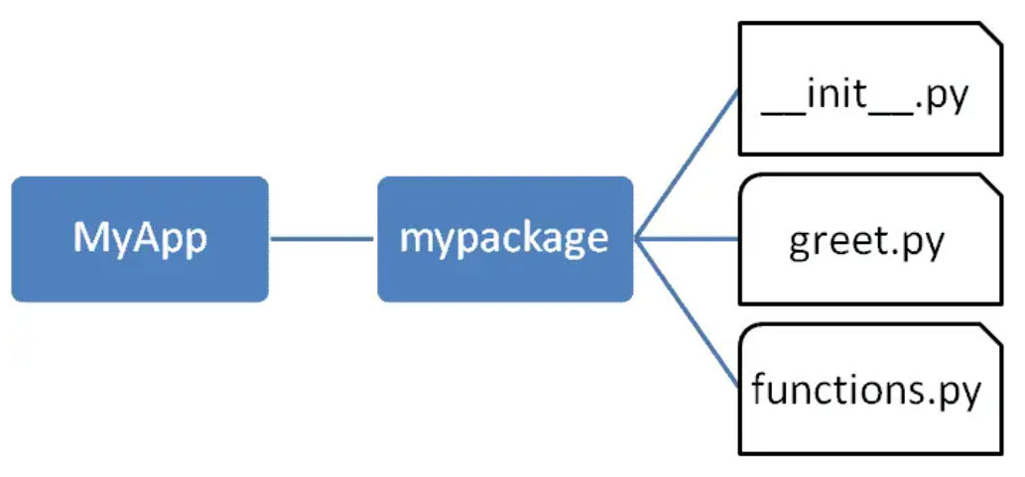
Creating a Package
This will create a package with the following folder structure:

Slide 75
Testing the Package
Go to MyApp folder and create test.py and run it
from mypackage import greet
greet.SayHello("CDAC")
from mypackage import functions
print(functions.power(3,2))
from mypackage.functions import sum
print(sum(10,20))
print(average(10,12)) # Error

Slide 76
Standard Library

Slide 77
Standard Library Basics
Standard Library is a collection of modules and packages that are included with Python and provide a wide range of functionalities
These modules cover areas such as file I/O, data manipulation, networking, web development, regular expressions, math, dates and times, and more
They allow you to perform various tasks without needing to write the code from scratch

Slide 78
Standard Library Modules and Packages - Examples
os and os.path: Operating system interfaces for tasks like file operations, directory manipulation, and environment variables
sys: System-specific parameters and functions.
math: Mathematical functions for basic and advanced mathematical operations.
datetime and time: Date and time manipulation, formatting, and calculations.
random: Generating random numbers and sequences.
json: JSON encoding and decoding.
csv: Reading and writing CSV (Comma Separated Values) files.
socket: Low-level networking interfaces.
urllib and urllib.request: Working with URLs, making HTTP requests, and fetching data from the web.
http and http.server: Building simple HTTP servers and clients.

Slide 79
Example Library – OS Module
The os module provides a way to interact with the operating system, allowing you to perform various tasks related to file and directory manipulation, environment variables, process management, and more
It provides a consistent interface across different operating systems

Slide 80
OS Module: File and Directory Operations
os.getcwd(): Get the current working directory
os.chdir(path): Change the current working directory
os.listdir(path): List the contents of a directory
os.mkdir(path): Create a directory
os.makedirs(path): Create directories recursively
os.remove(path): Remove a file
os.rmdir(path): Remove an empty directory
os.rename(src, dst): Rename a file or directory
os.path.join(path, *paths): Construct a path using the appropriate directory separator

Slide 81
OS Module: Working with Paths
os.path.abspath(path): Get the absolute path of a file or directory
os.path.exists(path): Check if a path exists
os.path.isfile(path): Check if a path is a regular file
os.path.isdir(path): Check if a path is a directory
os.path.basename(path): Get the base name of a path
os.path.dirname(path): Get the directory name of a path
os.path.split(path): Split a path into directory and file parts

Slide 82
OS Module: Running System Commands
os.system(command): Run a command in the system shell
os.popen(command): Open a pipe to or from a command

Slide 83
Object-Oriented Programming

Slide 84
Object-Oriented Programming (OOP)
Object-oriented programming (OOP) is based on the concept of objects, which can contain data and code to manipulate that data. In Python, everything is an object, including built-in data types like strings, integers, and lists.
Main OOP principles:
Encapsulation: This refers to the practice of hiding the implementation details of an object from the outside world, and only exposing a public interface that can be used to interact with the object.
Inheritance: This refers to the ability to create new classes that are a modified version of an existing class, inheriting the attributes and methods of the parent class.
Polymorphism: This refers to the ability of objects to take on multiple forms, based on their context or the methods that are being called on them.

Slide 85
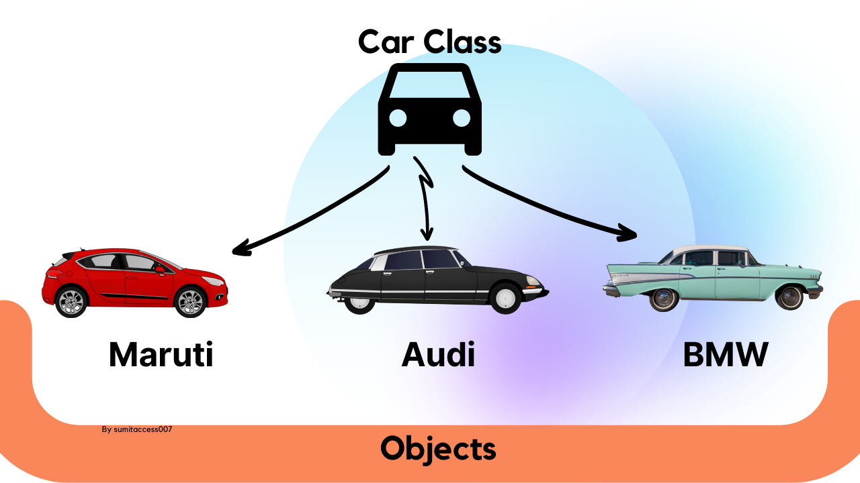
Class and Object Concept

Slide 86
OOP in Python
In a class method, you need to include self as the first parameter in the method signature, so that you can access the instance variables and methods of that instance within the method
class Person:
def __init__(self, name, age):
self.name = name
self.age = age
def say_hello(self):
print("Hello, my name is", self.name, "and I am", self.age, "years old.")
# Create an instance of the Person class
person1 = Person("Alice", 25)
# Call the say_hello() method on the person1 instance
person1.say_hello()
Constructor

Slide 87
Exercise
Create a Student class that has name, age, student_id and list of subjects as its attributes
Create two objects of this student class and display their information

Slide 88
Solution
class Student:
def __init__(self, name, age, student_id):
self.name = name
self.age = age
self.student_id = student_id
self.subjects = ["Computer Architecture", "Operating Systems"]
student1 = Student("Alice", 21, 1)
student2 = Student("Bob", 22, 2)
print(student1.age)
print(student2.subjects)

Slide 89
Exercise
Modify the Student class to add a display_information() method that displays the student attributes
Call this method to display all the information about the two student objects

Slide 90
Solution
class Student:
def __init__(self, name, age, student_id):
self.name = name
self.age = age
self.student_id = student_id
self.subjects = ["Computer Architecture", "Operating Systems"]
def display_information(self):
print(f"Name: {self.name}")
print(f"Age: {self.age}")
print(f"Student ID: {self.student_id}")
print(f"Subjects: {', '.join(self.subjects)}")
student1 = Student("Alice", 21, 1)
student2 = Student("Bob", 22, 2)
student1.display_information()
print()
student2.display_information()

Slide 91
Interaction between Multiple Classes
Class Student: Student id, name and list of results; has methods to add and retrieve results
Class Result: Represents a subject and the corresponding marks
Create a Student object, add results to it, and then print the student information and results

Slide 92
Code
class Student:
def __init__(self, student_id, name):
self.student_id = student_id
self.name = name
self.results = []
def add_result(self, subject, score):
result = Result(subject, score)
self.results.append(result)
def get_results(self):
return self.results
def __str__(self):
return f"Student ID: {self.student_id}, Name: {self.name}"
class Result:
def __init__(self, subject, score):
self.subject = subject
self.score = score
def __str__(self):
return f"Subject: {self.subject}, Score: {self.score}"
# Create a student and add results
student1 = Student(1, "Alice")
student1.add_result("Math", 95)
student1.add_result("Science", 88)
# Display student info and results
print(str(student1))
for result in student1.get_results():
print(result)

Slide 93
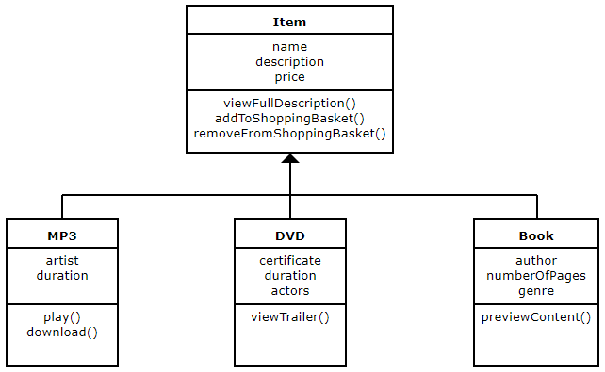
Inheritance

Slide 94
Inheritance
Inheritance is the ability to create a new class that is a modified version of an existing class, inheriting the attributes and methods of the parent class
The new class is called the child class or subclass, and the existing class is called the parent class or superclass
To create a child class, you use the class keyword followed by the name of the child class, and then the name of the parent class in parentheses

Slide 95
Inheritance Example
class Animal:
def __init__(self, name):
self.name = name
def speak(self):
raise NotImplementedError("Subclass must implement abstract method")
class Dog(Animal):
def speak(self):
return "Woof!"
class Cat(Animal):
def speak(self):
return "Meow!"
# Create instances of the Dog and Cat classes
dog1 = Dog("Fido")
cat1 = Cat("Fluffy")
# Call the speak() method on the instances
print(dog1.speak())
print(cat1.speak())

Slide 96
Explanation
We define an Animal class with a constructor method __init__ that takes one parameter name, and assigns it to an instance variable self.name. We also define a method speak that raises a NotImplementedError, indicating that this method must be implemented by any subclasses.
We then define two subclasses, Dog and Cat, that inherit from the Animal class using the syntax class ChildClass(ParentClass):. Each subclass overrides the speak method with its own implementation.
Finally, we create instances of the Dog and Cat classes, and call the speak method on each instance, which returns the appropriate sound for each animal.
Note that in the Dog and Cat classes, we don't need to define the __init__ method, since it's inherited from the parent class. We only need to define the methods that we want to modify or add to the subclass.

Slide 97
Inheritance: Bank Account Example
class BankAccount:
def __init__(self, account_number, balance):
self.account_number = account_number
self.balance = balance
def deposit(self, amount):
self.balance += amount
def withdraw(self, amount):
if amount > self.balance:
print("Insufficient balance.")
else:
self.balance -= amount
def display_balance(self):
print("Account balance:", self.balance)
class SavingsAccount(BankAccount):
def __init__(self, account_number, balance, interest_rate):
super().__init__(account_number, balance)
self.interest_rate = interest_rate
def calculate_interest(self):
interest = self.balance * self.interest_rate / 100
self.balance += interest
class CurrentAccount(BankAccount):
def __init__(self, account_number, balance, overdraft_limit):
super().__init__(account_number, balance)
self.overdraft_limit = overdraft_limit
def withdraw(self, amount):
if amount > self.balance + self.overdraft_limit:
print("Withdrawal amount exceeds overdraft limit.")
else:
self.balance -= amount
def display_overdraft_limit(self):
print("Overdraft limit:", self.overdraft_limit)

Slide 98
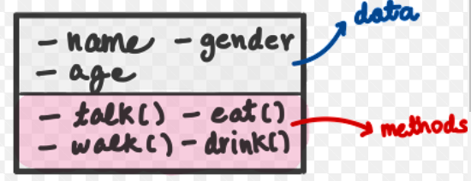
Encapsulation

Slide 99
Encapsulation Example
class BankAccount:
def __init__(self, account_number, balance):
self.__account_number = account_number # Private attribute
self.__balance = balance # Private attribute
def deposit(self, amount):
if amount > 0:
self.__balance += amount
def withdraw(self, amount):
if 0 < amount <= self.__balance:
self.__balance -= amount
else:
print("Insufficient funds")
def get_balance(self):
return self.__balance
def get_account_number(self):
return self.__account_number
def __str__(self):
return f"Account Number: {self.__account_number}, Balance: {self.__balance}"
# Create an instance of BankAccount
account = BankAccount("001", 1000.0)
# Accessing attributes using methods
print(account)
account.deposit(500.0)
account.withdraw(200.0)
print("Balance:", account.get_balance())
print("Account Number:", account.get_account_number())
# Direct access to private attributes is not recommended, but still possible
# Example: print(account.__balance) # This will raise an AttributeError
# Accessing private attributes using name mangling (not recommended)
print("Balance (name mangling):", account._BankAccount__balance)

Slide 100
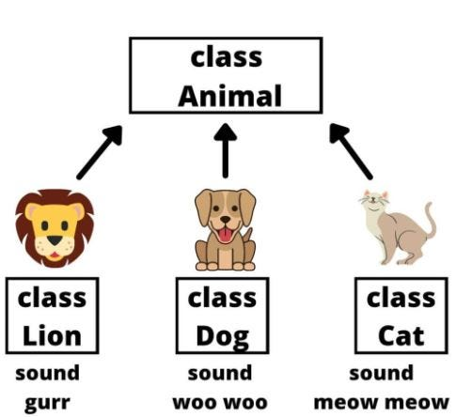
Polymorphism

Slide 101
Polymorphism Example
class BankAccount:
def __init__(self, account_number, balance):
self.account_number = account_number
self.balance = balance
def withdraw(self, amount):
if 0 < amount <= self.balance:
self.balance -= amount
else:
print("Insufficient funds")
def display(self):
print(f"Account Number: {self.account_number}")
print(f"Balance: ${self.balance:.2f}")
class SavingsAccount(BankAccount):
def __init__(self, account_number, balance, interest_rate):
super().__init__(account_number, balance)
self.interest_rate = interest_rate
def calculate_interest(self):
return self.balance * (self.interest_rate / 100)
class CheckingAccount(BankAccount):
def __init__(self, account_number, balance, overdraft_limit):
super().__init__(account_number, balance)
self.overdraft_limit = overdraft_limit
def withdraw(self, amount):
if amount <= self.balance + self.overdraft_limit:
self.balance -= amount
else:
print("Insufficient funds")
# Function to display account details and perform transactions
def perform_transactions(account):
account.display()
account.withdraw(200.0)
account.display()
print()
# Create instances of different account types
savings_account = SavingsAccount("SA001", 1000.0, 5.0)
checking_account = CheckingAccount("CA001", 1500.0, 200.0)
# Perform transactions using polymorphism
print("Performing transactions for Savings Account:")
perform_transactions(savings_account)
print("Performing transactions for Checking Account:")
perform_transactions(checking_account)

Slide 102
Constructor and Destructor Example
class Student:
def __init__(self, name, age):
self.name = name
self.age = age
print(f"{self.name} has been added to the class.")
def display(self):
print(f"Name: {self.name}")
print(f"Age: {self.age}")
def __del__(self):
print(f"{self.name} is leaving the class.")
# Create instances of the Student class
student1 = Student("Alice", 20)
student2 = Student("Bob", 22)
# Display information about the students
student1.display()
student2.display()
# Explicitly delete student1
del student1
# The destructor for student1 is called automatically when it goes out of scope
# At the end of the program, the destructors for all objects are automatically called

Slide 103
Complete Student Example
class Student:
def __init__(self, name, age, student_id):
self.name = name
self.age = age
self.student_id = student_id
self.subjects = ["Computer Architecture", "Operating Systems"]
def display_info(self):
print(f"Name: {self.name}")
print(f"Age: {self.age}")
print(f"Student ID: {self.student_id}")
print(f"Subjects: {', '.join(self.subjects)}")
class AIStudent(Student):
def __init__(self, name, age, student_id, specialization):
super().__init__(name, age, student_id)
self.specialization = specialization
self.subjects += ["Python", "Machine Learning"]
def display_info(self):
super().display_info()
print(f"Specialization: {self.specialization}")
print("Field: Artificial Intelligence")
class ProgrammingStudent(Student):
def __init__(self, name, age, student_id, specialization):
super().__init__(name, age, student_id)
self.specialization = specialization
self.subjects += ["Java", "C++"]
def display_info(self):
super().display_info()
print(f"Specialization: {self.specialization}")
print("Field: Programming")
class NetworkSecurityStudent(Student):
def __init__(self, name, age, student_id, specialization):
super().__init__(name, age, student_id)
self.specialization = specialization
self.subjects += ["TCP/IP", "Cryptography"]
def display_info(self):
super().display_info()
print(f"Specialization: {self.specialization}")
print("Field: Network Security")
# Creating instances of students in different specializations
ai_student = AIStudent("Alice", 20, "AI123", "Machine Learning")
programming_student = ProgrammingStudent("Bob", 22, "Prog456", "Web Development")
network_security_student = NetworkSecurityStudent("Charlie", 21, "NetSec789", "Cybersecurity")
# Displaying information about the students
ai_student.display_info()
print()
programming_student.display_info()
print()
network_security_student.display_info()

